Slide 1
The Mediator Pattern (Behavioral)

Slide 2
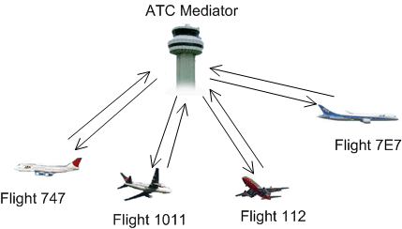
Mediator in the Real World

Slide 3
Motivation
Consider a situation where many objects need to communicate with each other. In the worst case, every object needs to know about every other object. The lines of communication can become overly complex and can inhibit reuse of the classes outside of the application context.
In some cases communication between the objects can be simplified by introducing an intermediate “mediator” object.
The mediator takes on the role of a hub or router and facilitates communication between the application classes.

Slide 4
Motivation (continued)
Without a Mediator
With a Mediator
O1
O2
O1
O1
O1
O3
O1
M
O1
O1
O1
10 possible paths
of communication
5 possible paths
of communication

Slide 5
Mediator Pattern
Intent: Define an object that encapsulates how a set of objects interact. Mediator promotes loose coupling by keeping objects from referring to each other explicitly, and it lets you vary their interaction independently.
Applicability: Use the Mediator pattern when
a set of objects communicate in well-defined but complex ways. The resulting interdependencies are unstructured and difficult to understand.
reusing an object is difficult because it refers to and communicates with many other objects.
a behavior that’s distributed between several classes should be customizable without a lot of subclassing.

Slide 6
Mediator Pattern Structure
Mediator
Colleague
ConcreteMediator
ConcreteColleague1
ConcreteColleague2

Slide 7
Mediator Pattern Typical Object Diagram
: Colleague
mediator
: Colleague
mediator
: Colleague
mediator
: ConcreteMediator
: Colleague
mediator
: Colleague
mediator

Slide 8
Mediator Pattern Participants
Mediator
defines an interface for communicating with Colleague objects.
ConcreteMediator
implements cooperative behavior by coordinating Colleague objects.
knows and maintains its colleagues.
Colleague classes
each colleague knows its mediator object.
each colleague communicates with its mediator whenever it would have otherwise communicated with another colleague.

Slide 9
Mediator Pattern Collaborations
Colleagues send and receive requests from a Mediator object.
The mediator implements the cooperative behavior by routing requests between appropriate colleagues.

Slide 10
Mediator Pattern Consequences
limits subclassing. A mediator localizes behavior that otherwise would be distributed among several objects. Changing this behavior requires subclassing Mediator only; Colleague classes can be reused as is.
decouples colleagues. A mediator promotes loose coupling between colleagues. You can vary and reuse Colleague and Mediator classes independently.
simplifies object protocols. A mediator replaces many-to-many interactions with one-to-many interactions between the mediator and its colleagues. One-to-many relationships are easier to understand, maintain, and extend.

Slide 11
Mediator Pattern Consequences (continued)
abstracts how objects cooperate. Making mediation an independent concept and encapsulating it in an object lets you focus on how objects interact apart from their individual behavior. That can help clarify how objects interact in a system.
centralizes control. The Mediator pattern trades complexity of interaction for complexity in the mediator. Because a mediator encapsulates protocols, it can become more complex than any individual colleague. This can make the mediator itself a monolith that is hard to maintain.

Slide 12
Mediator Pattern Implementation
There is no need to define an abstract mediator class when colleagues work with only one mediator. The abstract coupling that the Mediator class provides lets colleagues work with different Mediator subclasses, and vice-versa.
Colleagues have to communicate with their mediator when an event of interest occurs.
One approach is to implement Mediator as an Observer, where Colleagues notify the mediator whenever they change state and mediator propagates the change to other colleagues.
Another approach is to define a specialize communication interface in Mediator.

Slide 13
Mediator Pattern in Java
Most systems that facilitate asynchronous messaging implement some form of message bus as a mediator.
The Java Message Service (JMS) is a messaging API that allows application components to create, send, receive, and read messages. It enables distributed communication that is loosely coupled, reliable, and asynchronous.

Slide 14
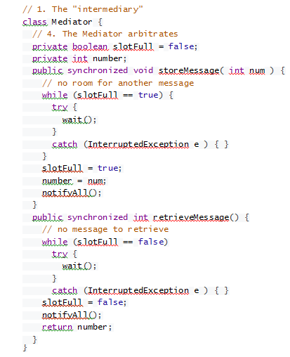
Example

Slide 15
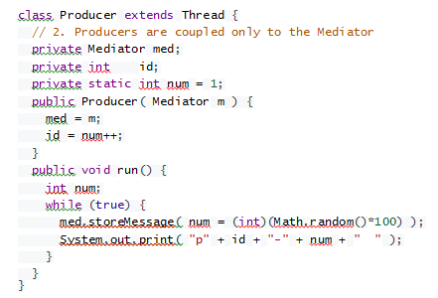

Slide 16
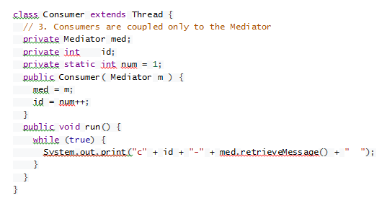

Slide 17
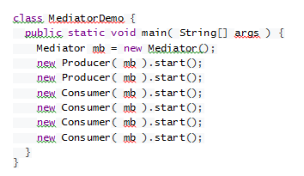

Slide 18
Related Patterns
Façade differs from Mediator in that it abstracts a subsystem of objects to provide a more convenient interface. Its protocol is unidirectional; that is, Façade objects make requests of subsystem classes, but not vice versa. In contrast, Mediator enables cooperative behavior, and the protocol is multidirectional.
Colleagues can communicate with the mediator using the Observer pattern.
(Note: JMS allows objects to communicate using this pattern.)

Slide 19
References
Mediator pattern (Wikipedia)
http://en.wikipedia.org/wiki/Mediator_pattern
Mediator Pattern (Object-Oriented Design)
http://www.oodesign.com/mediator-pattern.html
Mediator Design Pattern (SourceMaking)
http://sourcemaking.com/design_patterns/mediator
Open Message Queue
http://mq.java.net

